Slide 1


Project Presentation (KCS 753) (Bill Wise Pro) Project Id - PCS25-04
KIET Group of Institutions, Ghaziabad
(An ISO – 9001: 2008 Certified & ‘A+’ Grade accredited Institution by NAAC)
Guide Name: Mr. Akash Goel
Dev Varshney – 2200290129009
2. Shreshthi Tayal – 2100290120160
3. Vanshika Jain – 2100290120186
4.Viyapi Tyagi - 2100290120195

Slide 2
Problem Statement
In today's dynamic business landscape, the efficient management of billing processes is a critical aspect of ensuring financial stability and customer satisfaction. However, many businesses encounter challenges in handling their billing operations effectively. The existing billing systems often lack the necessary features, user-friendly interfaces, and automation capabilities required to streamline the invoicing process. Recognizing this gap, the problem statement for Bill Wise Pro emerges:
Manual and Time-Consuming Processes
Lack of Automation
Limited Customization
Poor Expense Tracking
Complex Client Management

Slide 3
Objectives
Efficiency and Automation
User-Friendly Interface
Accuracy and Error Reduction
Timely Payments and Reminders
Expense Tracking and Financial Visibility
Client Relationship Management
Integration with Payment Gateways
Security and Compliance
Scalability and Adaptability

Slide 4
Technology Used
Domain – Utility Software .
Frontend Development- React, Tailwind CSS, Toastify.
Backend Development- Express js, Node js.
Database- MySQL

Slide 5
Literature Survey
1.Paper title -E-Invoice Generator
Author name - Nita Dongre, Devendra Londhe, Rushikesh Khilare
Journal Name - International Research Journal of Engineering and Technology (IRJET)
Year of publishing – 2022
Followed by Summary of paper-

Slide 6
Summary of the Paper
The paper discusses the development and implementation of an electronic invoicing (e-invoicing) system aimed at improving the efficiency of business transactions. It highlights the transition from traditional invoicing methods to automated electronic systems which facilitate the sending, receiving, and processing of invoices with minimal human intervention.
Key features of the proposed system include:
Automation: It aims to reduce payment delays, minimize errors, and lower costs associated with printing and shipping invoices.
User-Friendly: The system is designed to be simple and accessible, especially beneficial for small and medium-sized enterprises that may face challenges in implementing complex e-invoicing solutions.
Security and Compliance: The paper emphasizes the importance of secure access to business transactions to prevent fraud and comply with regulatory standards.
Additionally, the impact of e-invoicing on buyer-seller relationships is explored, highlighting improvements in communication and operational links between parties. The implementation of e-invoicing can help limit fraudulent activities by providing tax authorities real-time access to transaction data, thereby enhancing accountability and efficiency in the invoicing process.
Overall, this system aims to create interoperability within the GST ecosystem, ensuring that invoices are machine-readable and can be uniformly interpreted across different platforms.

Slide 7
2. Paper title - Inventory and Bill Management System
Author name - Mr. Aditya Vaibhav Pawar and Mr. Nilesh Vishwas Patil
Journal Name - International Journal of Advanced Research in Science, Communication and Technology (IJARSCT)
Year of publishing - April 2024
Followed by Summary of paper-

Slide 8
Summary of the Paper
This research paper presents a comprehensive case study on the development and implementation of an Inventory and Bill Management System, aimed at enhancing efficiency in inventory tracking and billing processes. The system is designed to automate tasks such as invoice generation and inventory management, addressing the manual inefficiencies faced by businesses like Shri Swami Samarth Enterprises. The study highlights the collaborative approach taken by the authors and the sponsor, focusing on user authentication, dashboards for reporting, and streamlined operations to significantly improve accuracy and productivity. The major outcomes include enhanced customer management, reduced errors in billing, and improved operational efficiency, ultimately contributing to business growth. The paper also discusses the future scope of the system, including scalability, integration with other tools, and enhanced reporting capabilities.

Slide 9
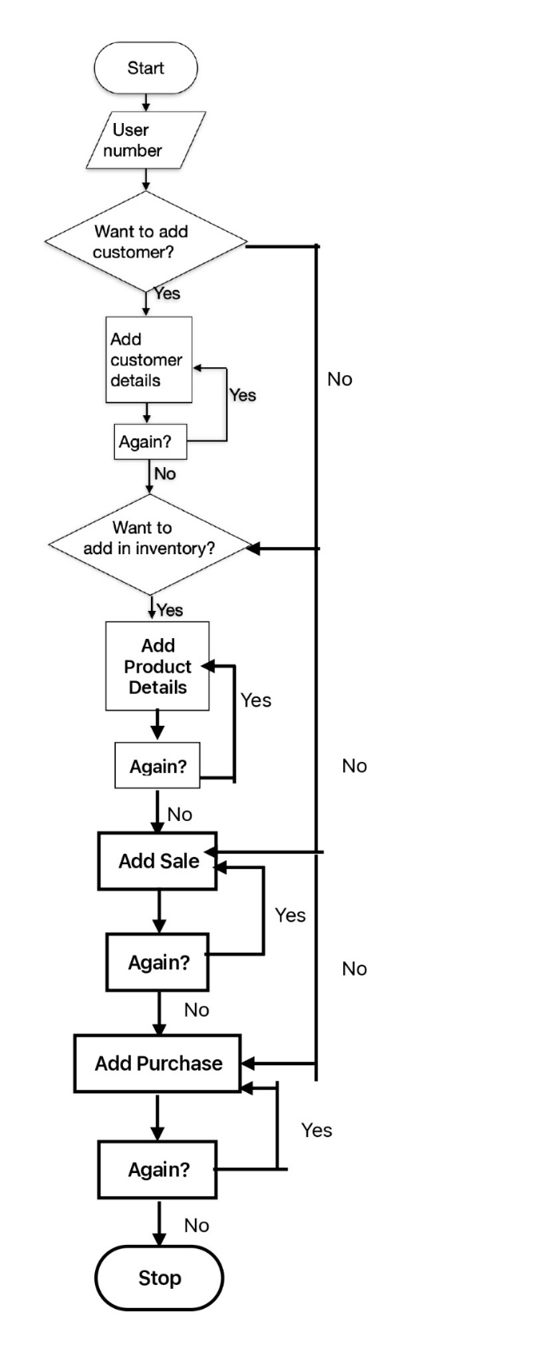
Workflow Diagram

Slide 10
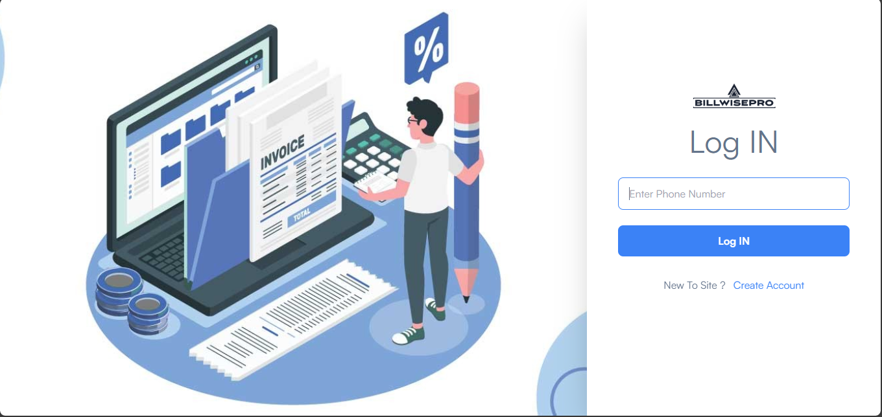
Screen Shots of Working Project -

Slide 11
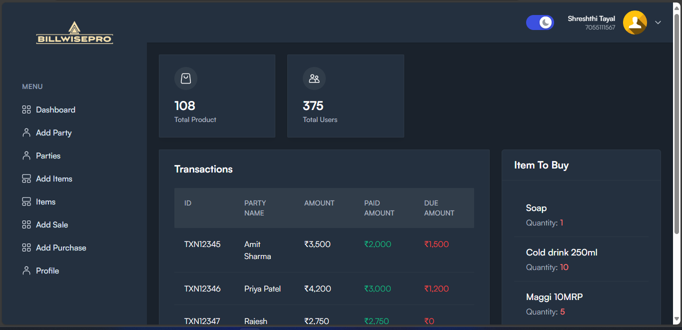

Slide 12
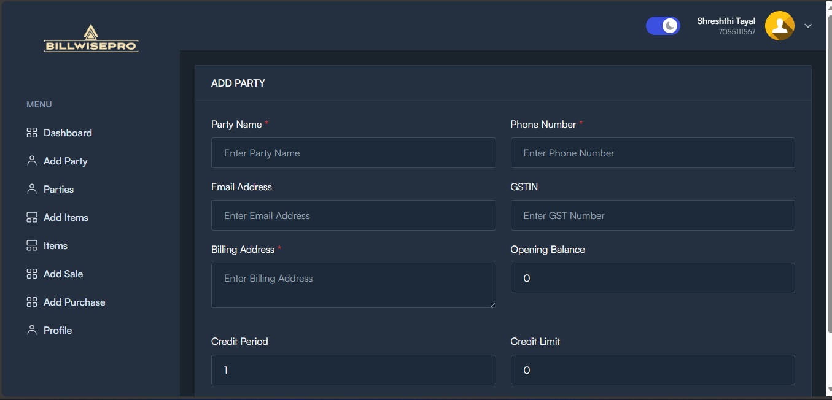

Slide 13
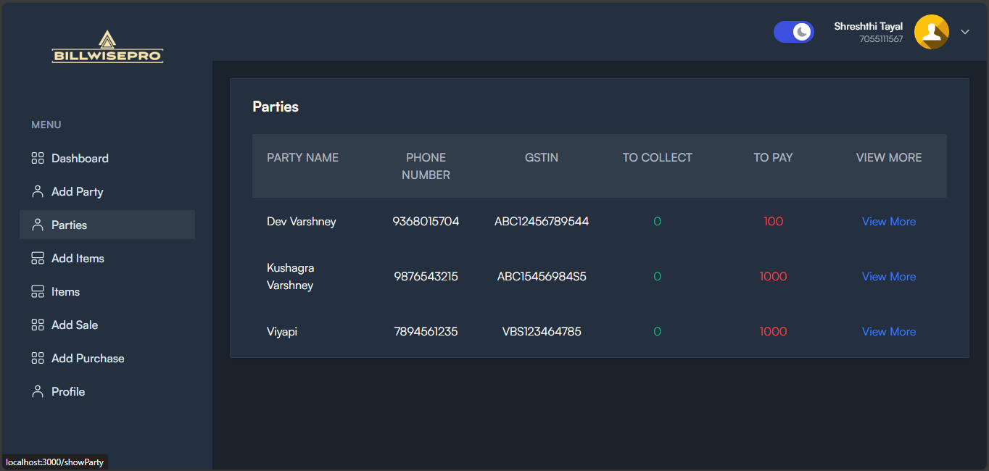

Slide 14
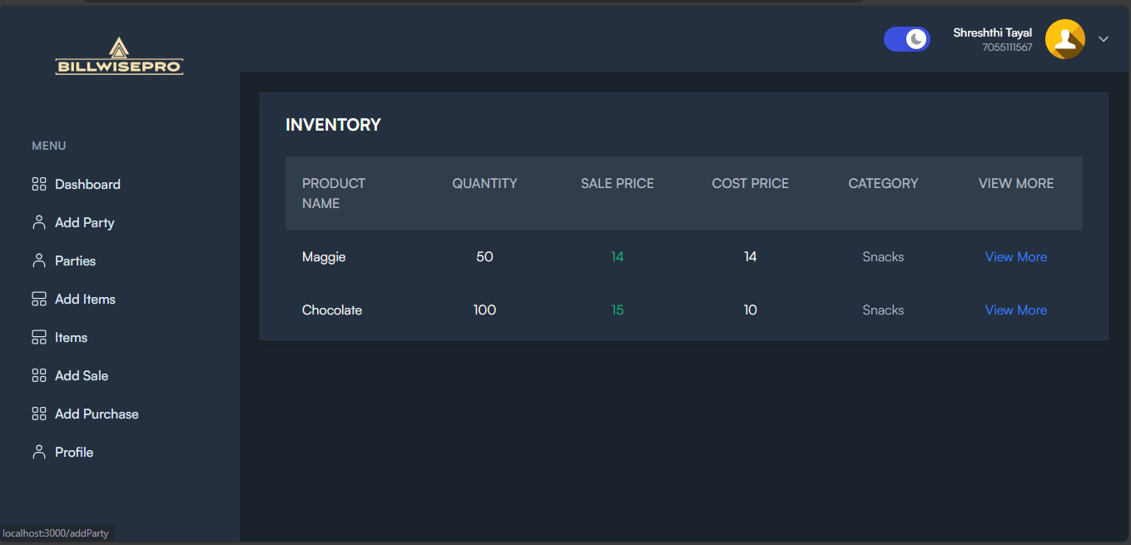

Slide 15
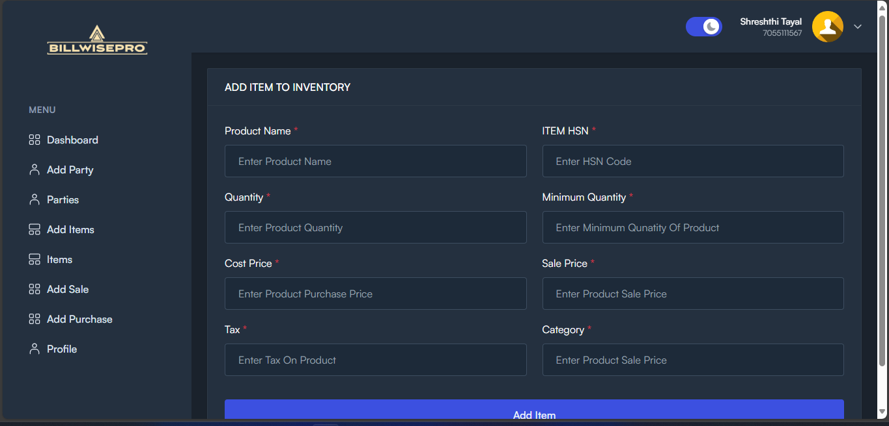

Slide 16
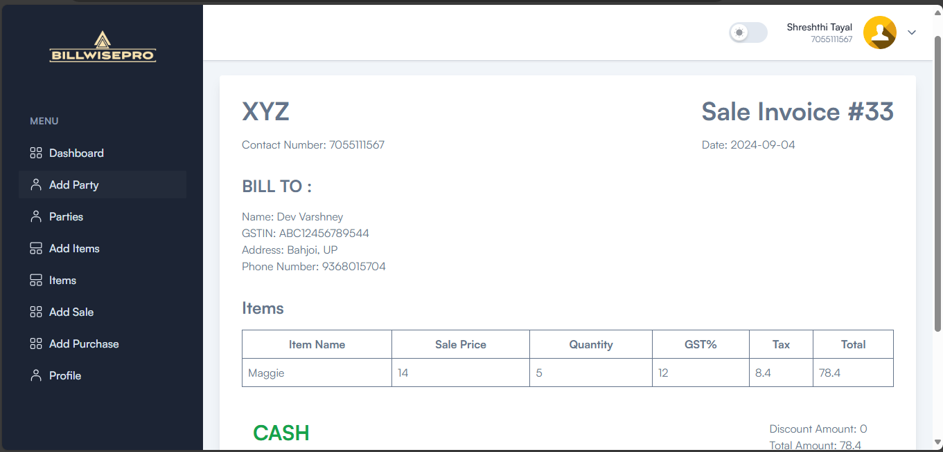

Slide 17
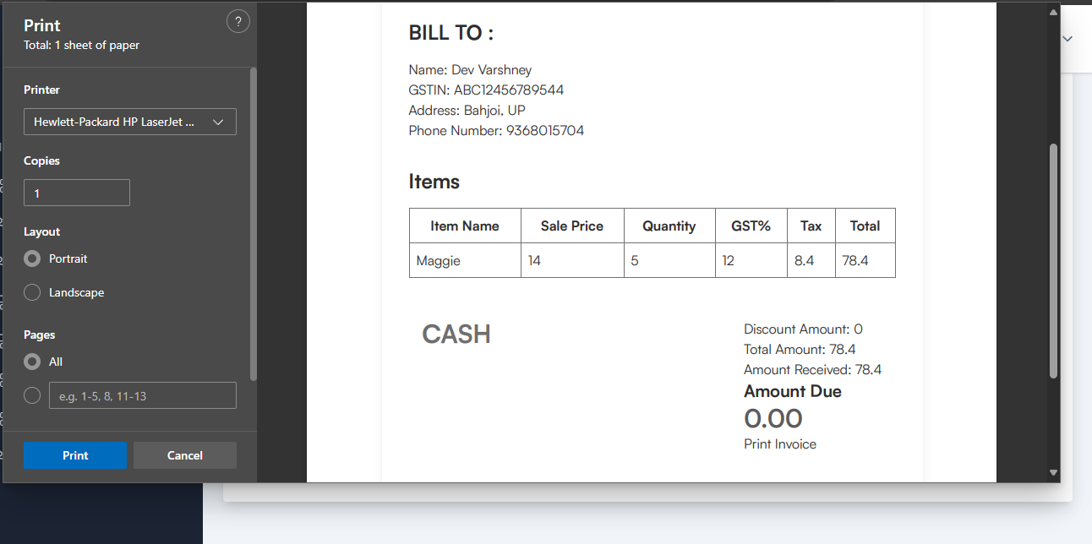

Slide 18
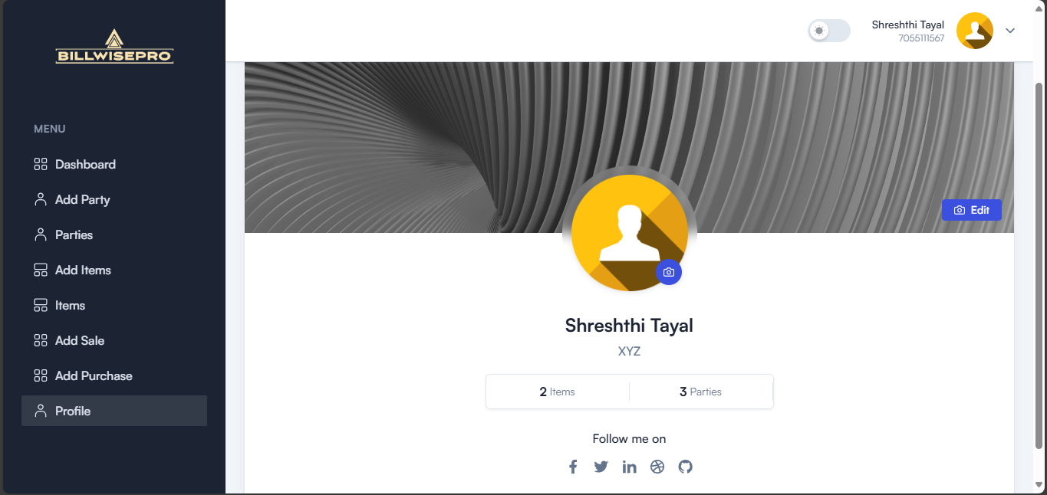

Slide 19
References
A. Smith, "The Role of Automation in Billing Software for SMEs," *IEEE Trans. Autom. Sci. Eng.*, vol. 10, no. 2, pp. 50-60, 2023. DOI: 10.1109/TASE.2023.1234567
B. Johnson, "Inventory Management Best Practices in SMEs," *J. Bus. Process Manag.*, vol. 15, no. 4, pp. 85-92, 2022. DOI: 10.1016/j.bpm.2022.04.012
M. Lee, "Real-Time Dashboard for Business Operations," in *Proc. 2021 Int. Conf. Softw. Eng.*, New York, NY, USA, 2021, pp. 145-150. DOI: 10.1145/3365665.3365672
Mr. Aditya Vaibhav Pawar and Mr. Nilesh Vishwas Patil, " Inventory and Bill Management System," International Journal of Advanced Research in Science, Communication and Technology (IJARSCT), April 2024
- Nita Dongre, Devendra Londhe, Rushikesh Khilare, "E-Invoice Generator," International Research Journal of Engineering and Technology (IRJET), 2022

